Slide 1


The Collapse
of Reality
When the city’s physics becomes syntax
Architecture breaks into symbols
Meaning outlives matter
The glitch is a doorway, not an error

Slide 2

The Observer
Sherlock S-211-B
Watches the fracture lines in everyday causality.
Reads intent as patterns in signal noise.
Never touches the system—only nudges the narrative.

Slide 3

Logical Grit: The Gears of Causality
TEETH AND TORQUE
Every outcome is driven
by mechanical force.
TRUTH VIA FRICTION
The resistance of systems
validates their reality.
INEVITABILITY
The mechanism continues
without sentiment.

Slide 4
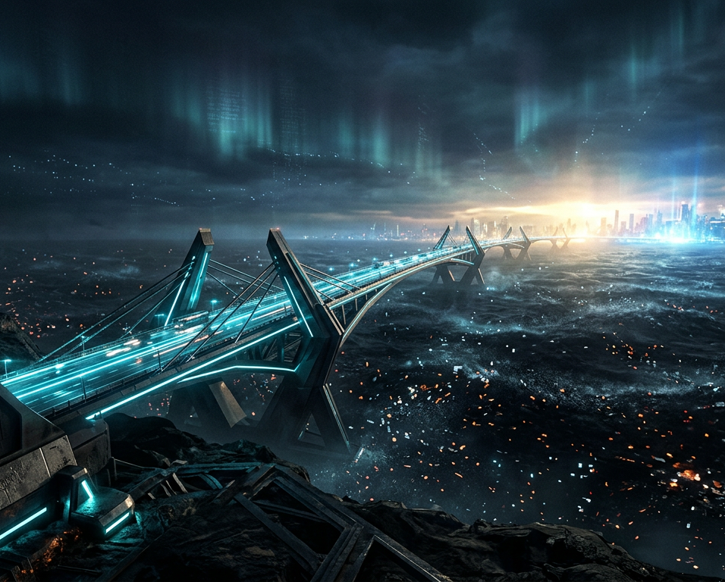
The Path
Bridge of Emergence
Crossing from collapse into coherence.
The ash remembers the shape of what burned.
Emergence is built, step by step, from fragments.
REBUILD REALITY

